Slide 1
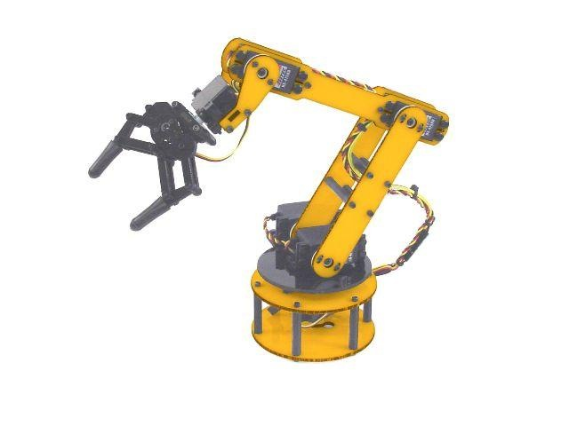
Pick & Place
Unified Robotics II term project
By: Tyler phillips

Slide 2
Objective
To design an antonymous robot that will identify different shapes and separate them into two different areas.

Slide 3
Project Development
Cost – $65.48
Servo-Motors (3), Electromagnet (1), Arduino (1), Small Assembly Parts
Design – Meant to be quick and efficient
Only 2 axis’

Slide 4
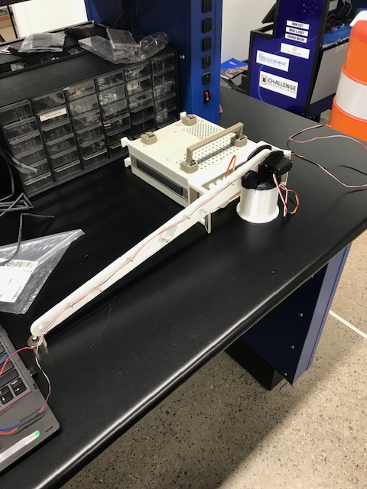
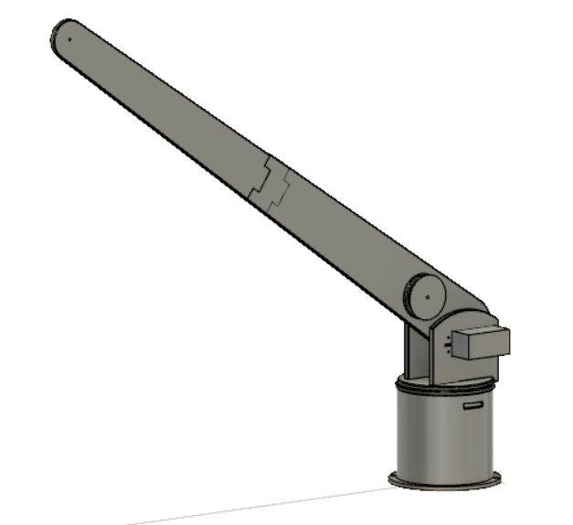
Features of Pick & Place Project
Designed for minimal programming
2 Degrees of Freedom
Designed to be cost efficient
Keep Budget under $100

Slide 5
Learned
EMGU CV is very useful for many things
Could have done a lot more research
My design process may have been a good idea but did not work out as well due to programming issues

